Slide 1
ELEMENTARY STATISTICS, BLUMAN
Area Under Normal Curve Using Table (Example 3)
© 2019 McGraw-Hill Education. All rights reserved. Authorized only for instructor use in the classroom. No reproduction or further distribution permitted without the prior written consent of McGraw-Hill Education.

Slide 2
Objectives for this PowerPoint
Learn how to find probabilities associated with a normally distributed variable using the normal distribution table.

Slide 3

Example (1)
Using the standard normal distribution find the probability that a randomly selected standardized value from a normally distributed variable is less than -1.51.
$$P(z<−1.51)$$

Slide 4
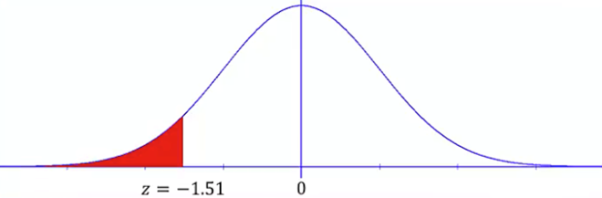
Example (2)
This can also be described as finding the area under the normal curve that is below 1.51 standard deviations to the left of the mean.

Slide 5
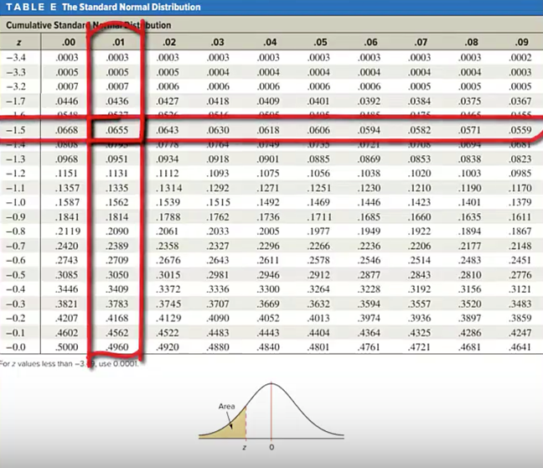
Example (3)
The cumulative standard normal distribution table gives us probabilities associated with z-scores. We are looking for the probability associated with the z-score -1.51. We will find the entry in the table where the row -1.5 intersects with the column .01

Slide 6
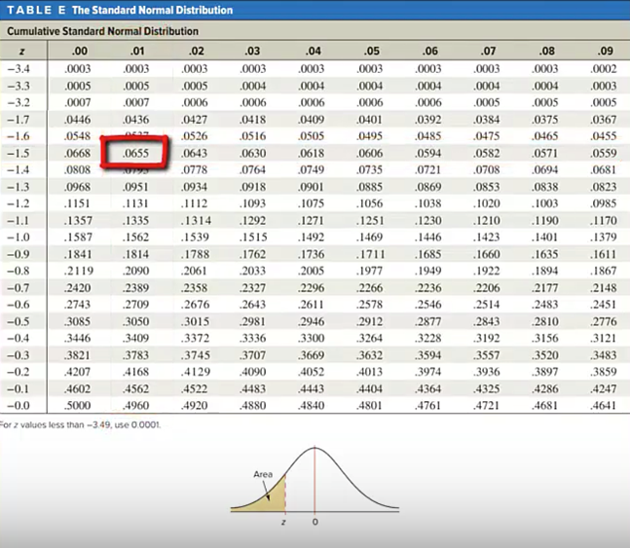
Example (4)
We find this value to be point 0.0655

Slide 7
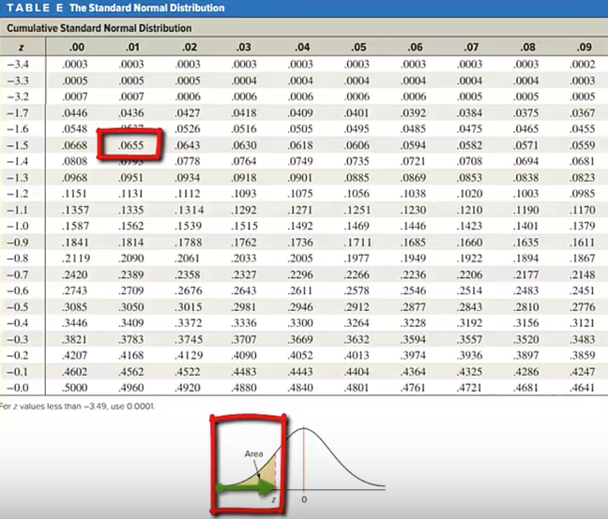
Example (5)
The graph at the bottom of the table shows that these 4 decimal place values in the body of the table correspond to the area under the curve that extends from the left-tail up to the z-score.

Slide 8
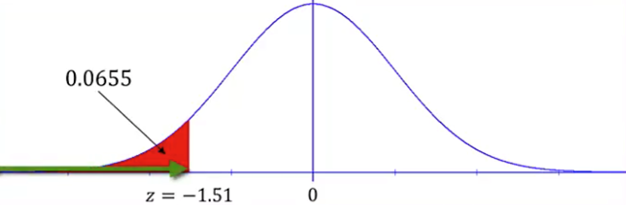

Example (6)
This value 0.0655 would correspond to the area under the curve that extends from the left-tail up to the z-value -1.51.
$$P(z<−151)$$

Slide 9

Example (7)
In probability notation we would write the probability as the following:
$$P\left(z<−1.51\right)=0.0655$$

Slide 10
Summary
In this PowerPoint we learned how to find probabilities associated with a normally distributed variable using the normal distribution table.

